Slide 1
Multi-Page Responsive Website
By Ahmad Syed Semar

Slide 2
Home Page
The home page serves as the landing page of your website. It provides an overview or introduction to your website's purpose or content. It includes two buttons, one for registering and another for logging in. Users can click on these buttons to navigate to the respective pages and perform the desired actions.

Slide 3
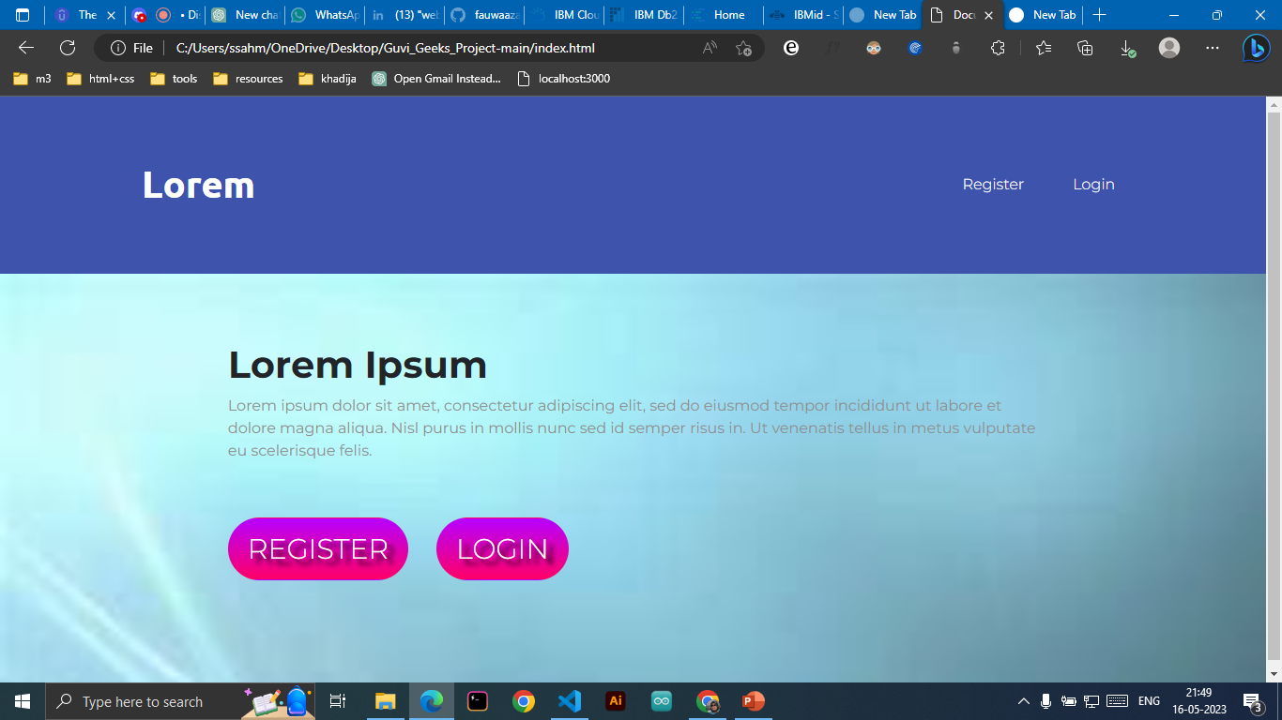

Slide 4
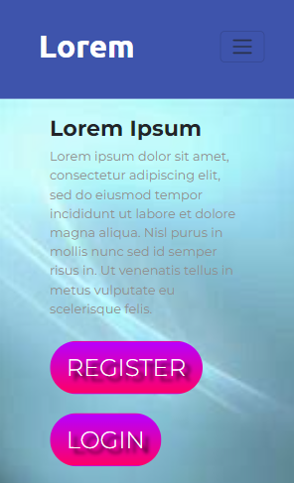
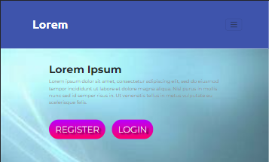

Slide 5
Register Page
The register page is where new users can create an account on your website. It typically includes a form where users can enter their basic registration details, such as username, email address, password, etc. Once the user fills in the required information and submits the form, it will validate the input and, if successful, redirect the user to the login page.

Slide 6
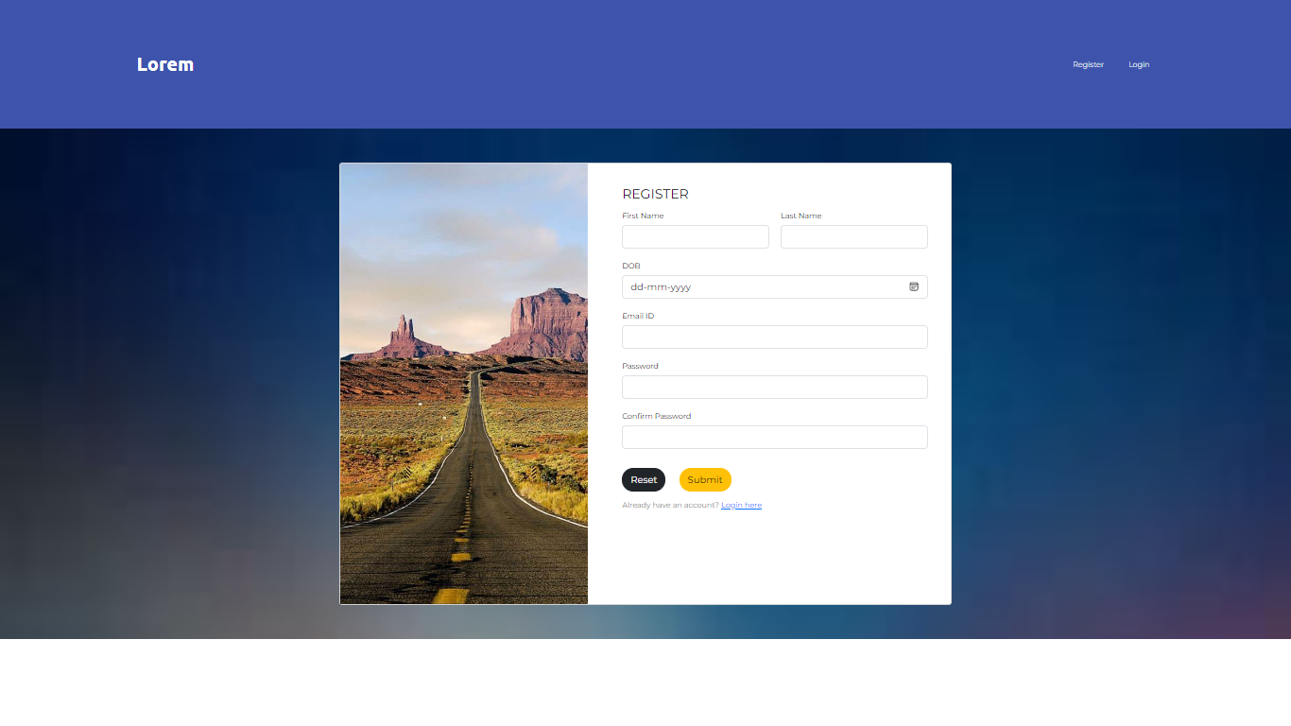

Slide 7
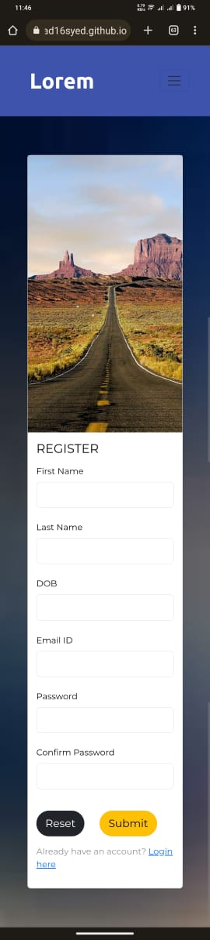
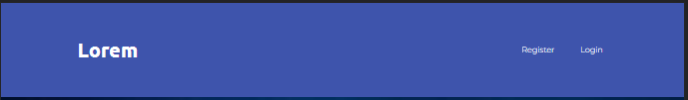
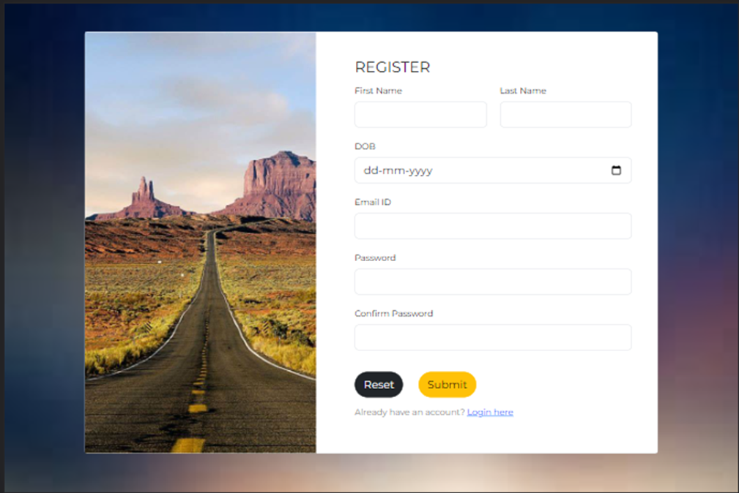

Slide 8
Login Page
The login page allows registered users to access their accounts. It features a login form where users can enter their credentials, such as username/email and password. Upon submission, the login page verifies the entered information against the stored user data. If the login is successful, it redirects the user to their profile page.

Slide 9
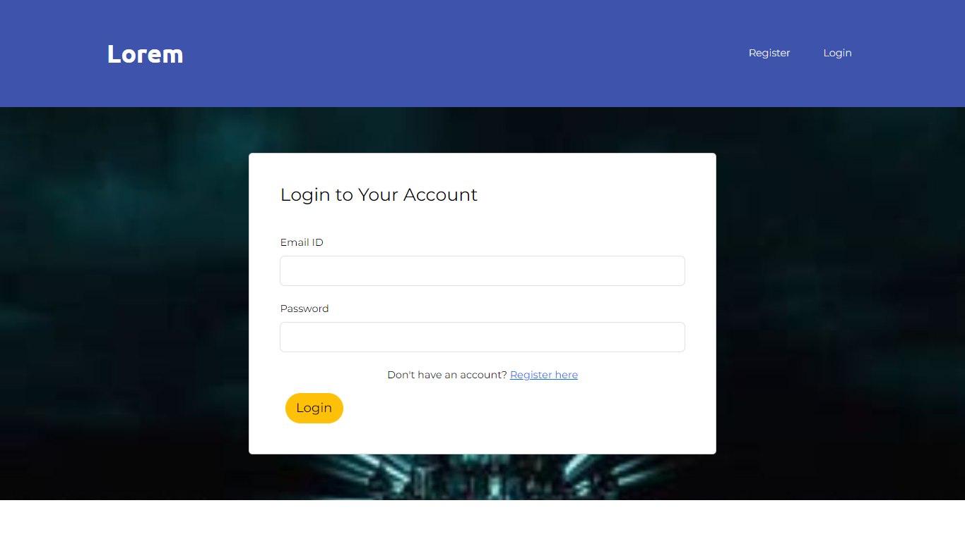

Slide 10
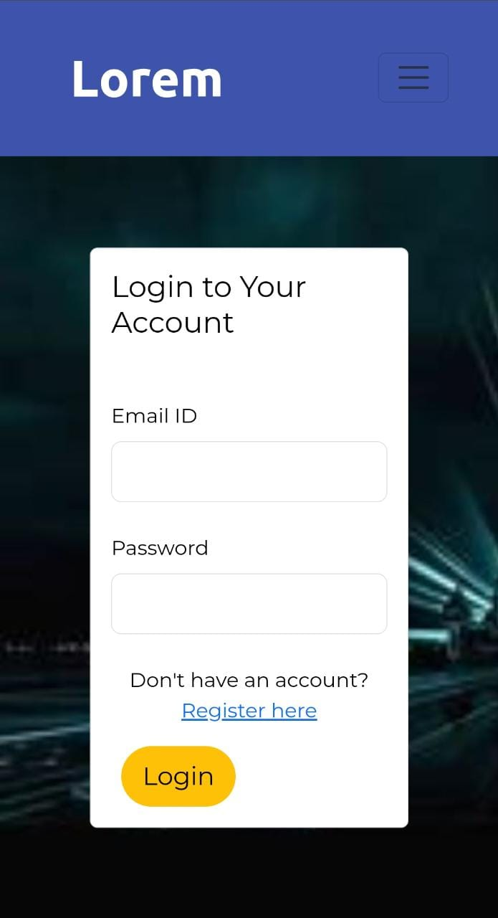
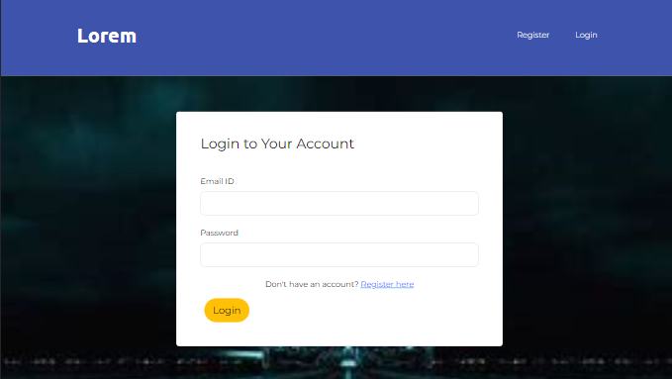

Slide 11
Profile Page
The profile page displays personalized information and settings for a logged-in user. It typically includes the user's profile picture, name, and other relevant details. Users can also edit their profile information, such as updating their profile picture, changing their username, or modifying other settings. This page allows users to manage and customize their personal information within the context of your website.

Slide 12
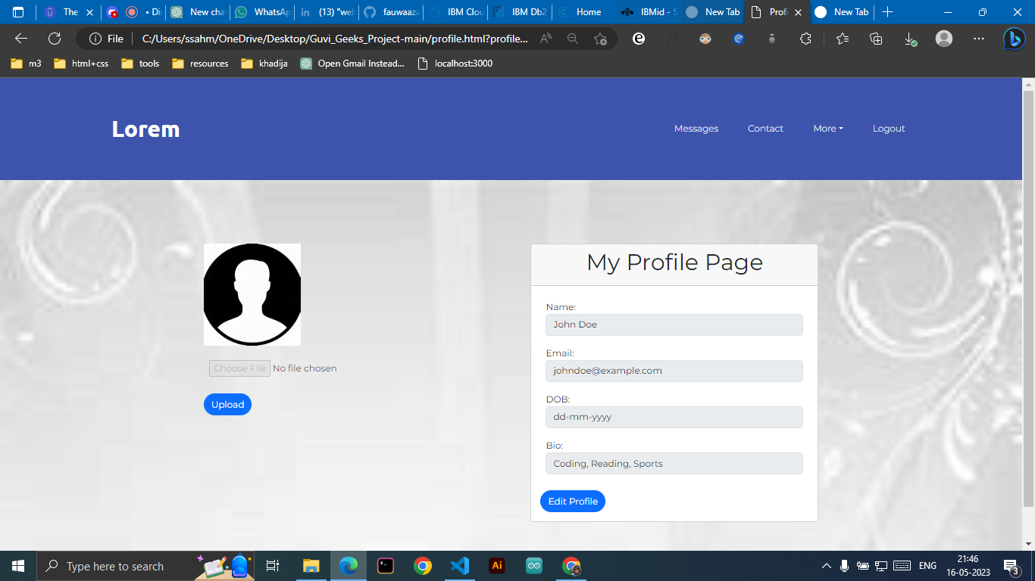

Slide 13
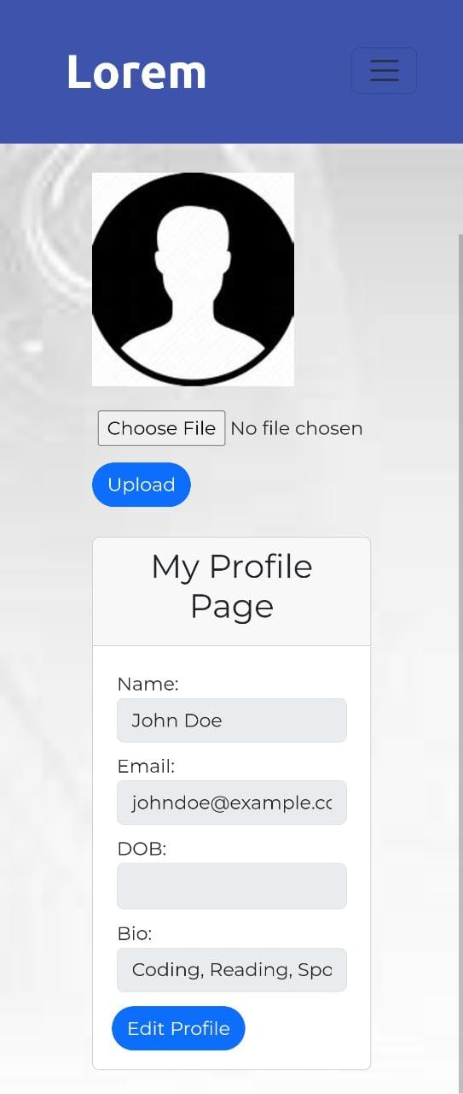
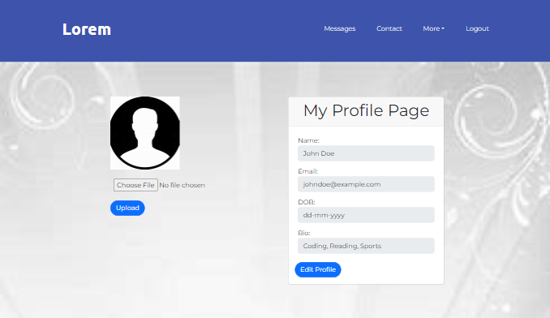

Slide 14
Conclusion
This website incorporates responsive design principles. This means that when viewed on smaller screens like tablets or smartphones, the navigation bar buttons transform into a hamburger icon. This responsive behavior ensures that users can easily access the navigation menu and navigate through the website, even on devices with limited screen space.
Overall, This multipage responsive website provides a user-friendly experience by allowing visitors to register, login, manage their profiles, and seamlessly adapt to different screen sizes.

